Slide 1


International Student Orientation
Notes:
This is an app for international students.

Slide 2

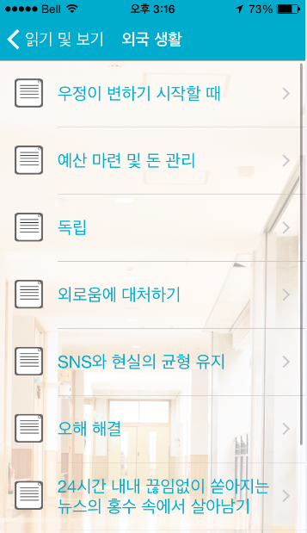
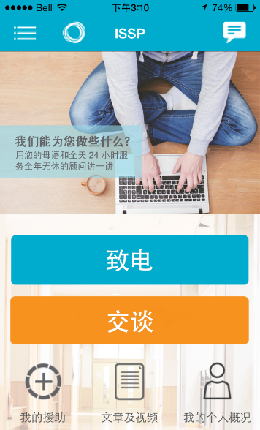
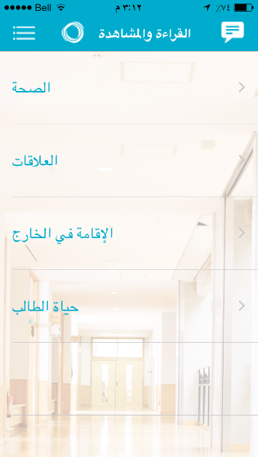
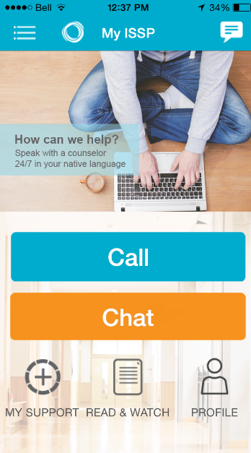




Let’s download the My SSP app: Search ‘My SSP’
Why not install the app on all your phones today? Search for My SSP and Morneau Shepell in the App store or on Google Play
Notes:
For international students:
Go the to app store
Type in My SSP
And it is the first one.

Slide 3
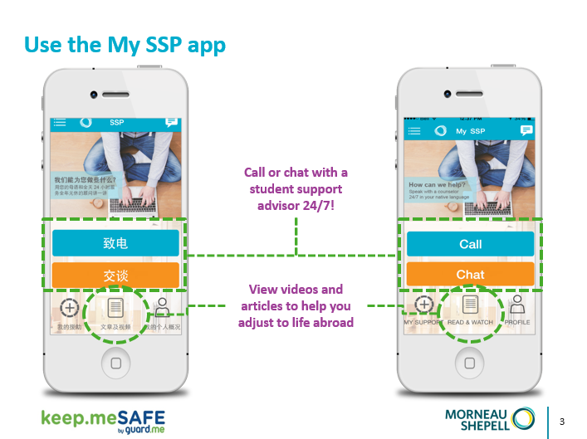

Slide 4





Keep.me SAFE can help with tips on:
Adapting to daily life
Making friends at school
How to be successful at school
Dealing with stress
Being healthy

Slide 5

What is Keep.me SAFE?
Our Student Support Advisors are available 24/7 to help you succeed while studying abroad.
Speak to a Student Support Advisor who speaks your language and understands your culture.
FREE and confidential
No one will know that you’ve reached out, unless you choose to tell them!

Slide 6
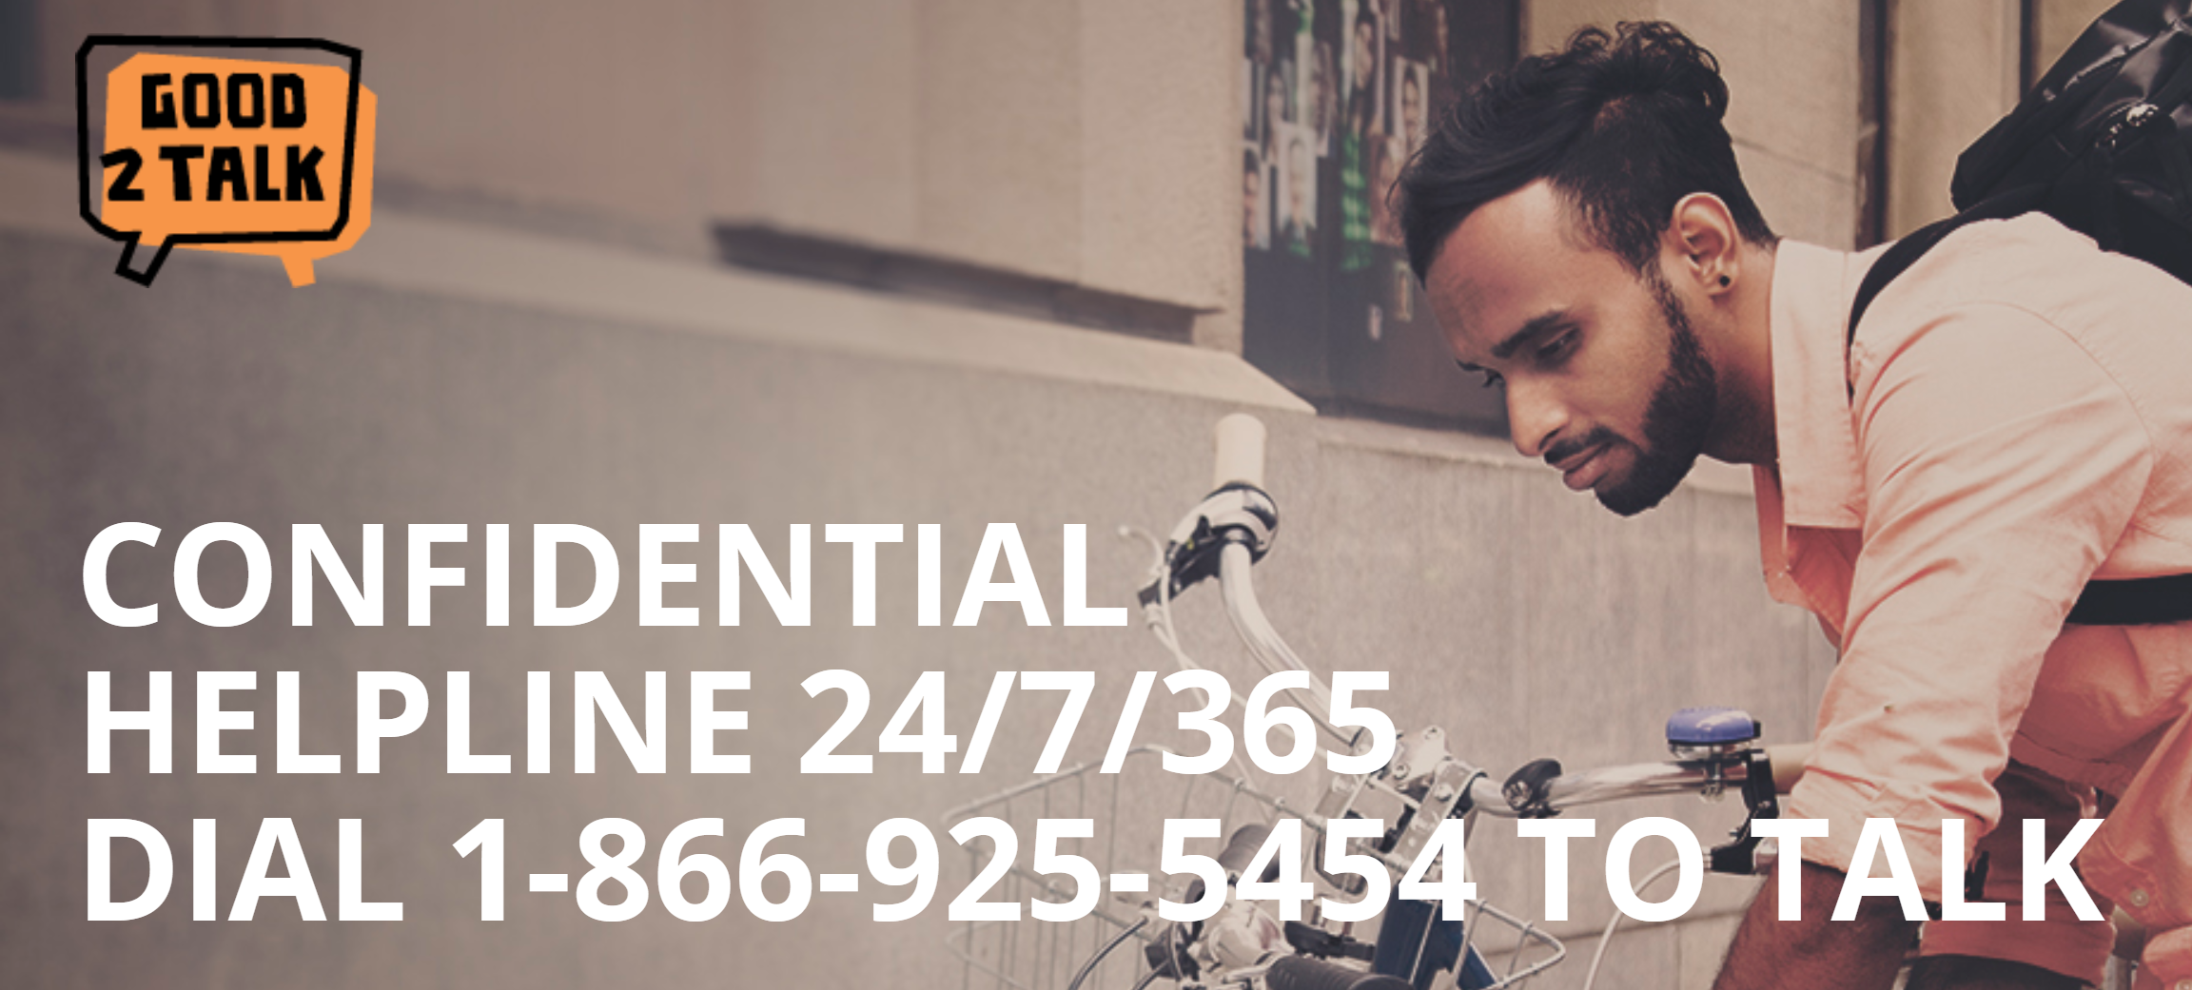
What is Good2Talk?
Good2Talk is a free confidential helpline that provides professional counselling and information and referrals for the health and well-being to post-secondary students in Ontario, 24/7/365.
Notes:
For anyone else who is not an international student, Good2talk is available for all post-secondary students to ask questions as well.

Slide 7

Thank you for your time!
For more information:
Visit the website www.keepmesafe.org
Dial: 1.866.743.7732 to speak with an advisor over the phone!
Download the free My SSP App Today!
Notes:
Contact the ISC if you have questions about the app!

